Slide 1

OPEN
DATA
SCIENCE
CONFERENCE
@ODSC

Slide 2
Data Science + Design Thinking: a perfect blend to achieve the best user experience
ODSC East 2019
Michael Radwin
Vice President, Intuit

Slide 3







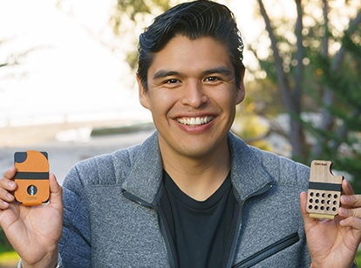


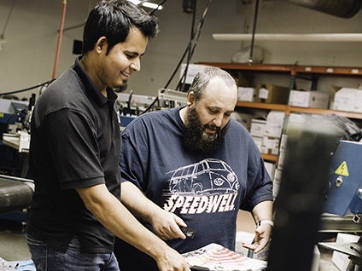

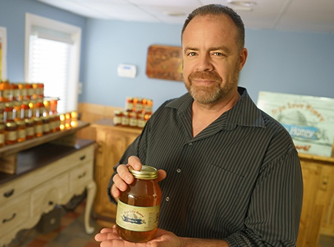
Who we serve:
Consumers
Small businesses
Self-employed

Slide 4

Great AI, bad design

Slide 5



Data science vs. design mindsets
AUC
PRECISION/RECALL
LABELS
MODELS
UNSUPERVISED
CLUSTERING
K-MEANS
HYPER-PERAMETER TUNING
3-CLICK RULE
5-SECOND TEST
60-30-10 RULE
GOLDEN RATIO
F-SHAPED PATTERN
WIREFRAME
CARD SORTING
HEATMAP

Slide 6
How can we come together?

Slide 7

Solution: Design for Delight
Deep customer empathy
Go broad to go narrow
Rapid experiments with customers
Notes:
Grounding the audience on CDI/D4D
This is how we solve big, important problems at Intuit. Using these frameworks to connect, create, test, iterate, and deliver solutions that create real benefit for our customers.
And it begins with honest human connection.

Slide 8
Solution: Design for Delight
Deep customer empathy
Go broad to go narrow
Rapid experiments with customers

Slide 9
Solution: Design for Delight
Deep customer empathy
Go broad to go narrow
Rapid experiments with customers

Slide 10
Solution: Design for Delight
Deep customer empathy
Go broad to go narrow
Rapid experiments with customers

Slide 11
Examples of design thinking applied to Intuit’s data science product features

Slide 12

Mint Overdraft Prediction
Notes:
Remember our team at QBSE?
In the case of QuickBooks self–employed, let’s look at the “more money” metric.
In this case it relates to how much money in potential tax savings their customers get at tax time.
Recall from their FMH’s..?
For people who don’t track expenses, this number might be zero,
TARGET TIME:

Slide 13

Problem:
Americans pay billions of dollars in overdraft fees every year when they have insufficient funds.
50% of those fees are for transactions totaling less than $50.
The average overdraft fee is $35.
It’s hard for people to get ahead.

Slide 14
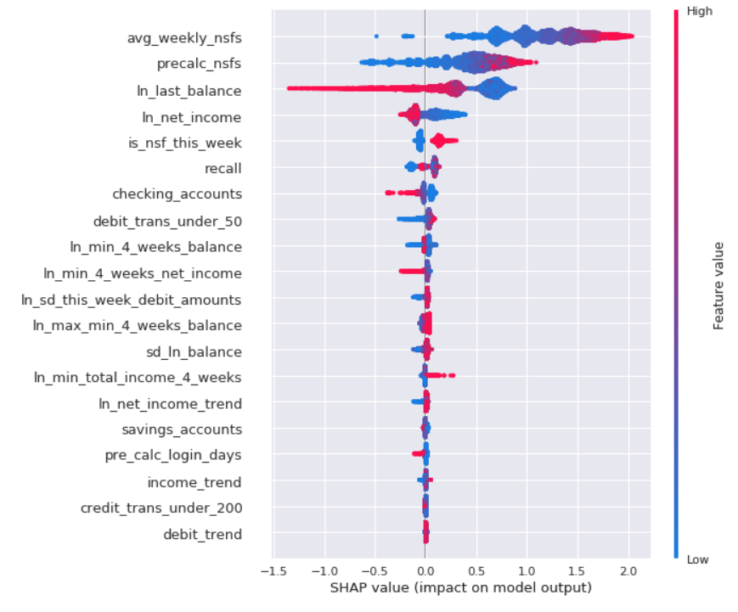
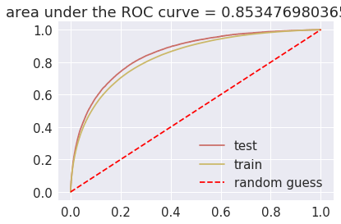
We built a supervised ML model to predict overdraft

Slide 15

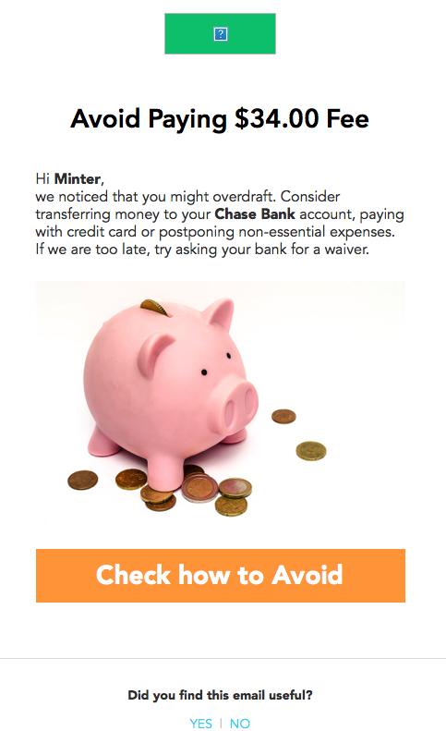

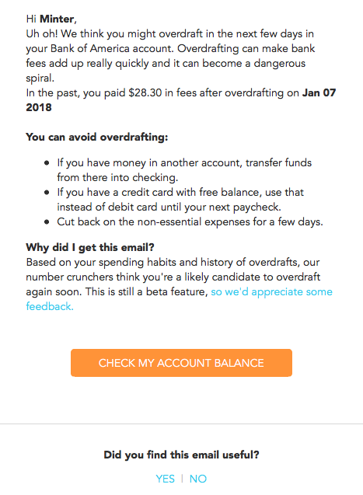
Mint customers have saved nearly $1M in overdraft fees over the past 12 months.
The overdraft prediction service sent more than 650K alerts to help users avoid paying non-sufficient funds fees.
Before
After
Avoid overdrafting your Bank of America account by taking
action

Slide 16

QuickBooks Self-Employed SmartGroups
Notes:
Remember our team at QBSE?
In the case of QuickBooks self–employed, let’s look at the “more money” metric.
In this case it relates to how much money in potential tax savings their customers get at tax time.
Recall from their FMH’s..?
For people who don’t track expenses, this number might be zero,
TARGET TIME:

Slide 17

Problem:
Business-related trips are tax-deductible for the self-employed.
The QuickBooks Self-Employed mobile app automatically tracks trip miles.
It’s time-consuming to review trips to determine which are personal and which are for business.

Slide 18
We used pattern mining to group business vs. personal trips
Sample business trip data for a user
Trip_id | Start_location | End_location | Is_weekend_trip
12345 | A | B | False
34394 | A | B | False
15353 | A | C | True
34293 | A | B | False
46483 | B | A | True
21632 | A | B | False
Notes:
For example, let’s consider that these are the business trips of a particular user, and assume that these are the only features we have for each trip: start and end locations, and whether or not a trip occured over the weekend

Slide 19
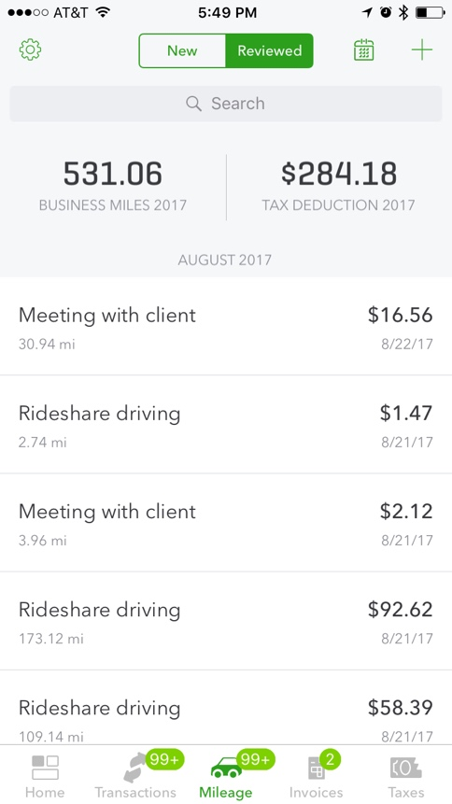
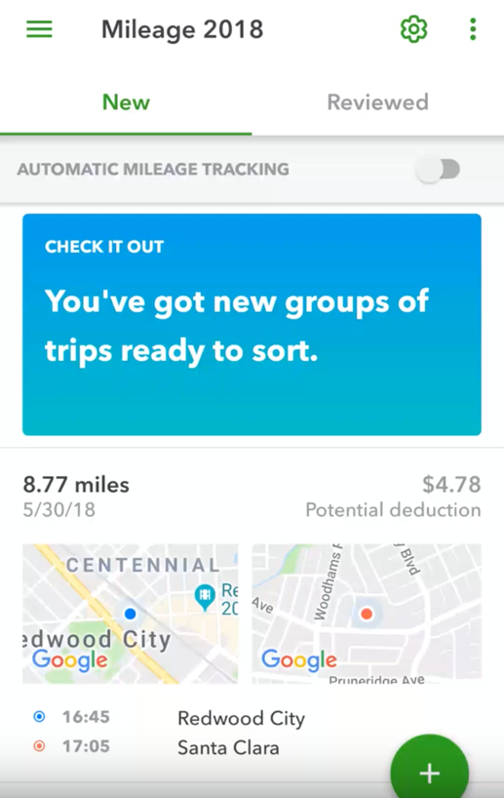
Customers categorize an average of 100 trips/month in significantly less time.
The experience is tailored to a customer’s individual driving patterns.
Before
After

Slide 20

TurboTax Standard vs. Itemized (SVI) Deduction

Slide 21

Problem:
American taxpayers waste time itemizing deductions, only to find that they should take the standard deduction.
TurboTax was able to quickly predict which deduction was right for the customer.
But customers didn’t have confidence that we knew enough about them to make an accurate prediction.

Slide 22
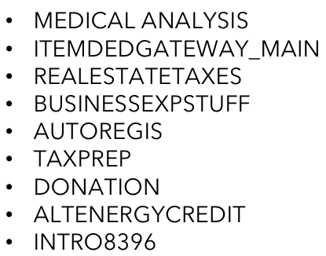
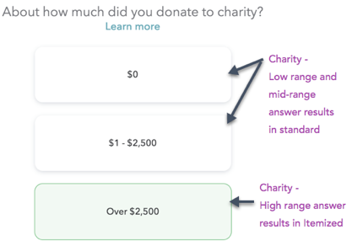
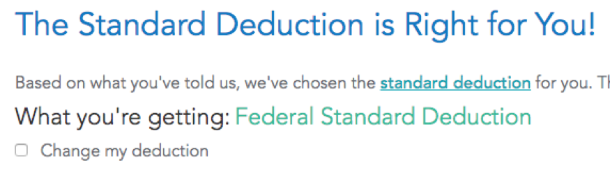
It wasn’t enough to build an SVI deduction prediction model
INPUT:
PTT output
GTKM output
Prev year
PI, SchA,
Income , etc.
SVI
Model
Itemized (Baseline) Experience
Itemized
Deduction
SVI Interview
Alternative
Experience
Standard
Deduction

Slide 23
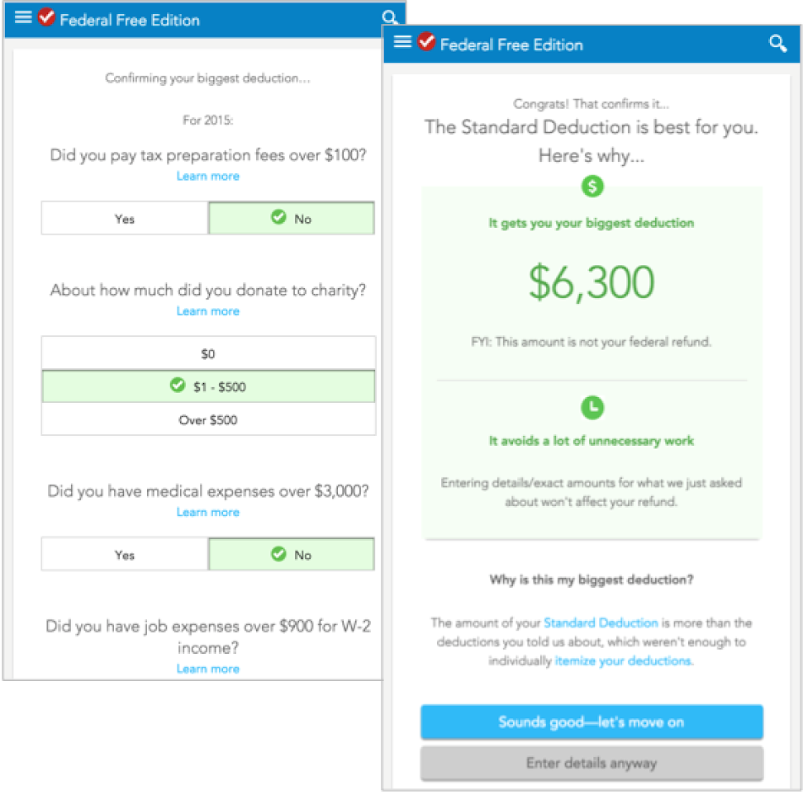
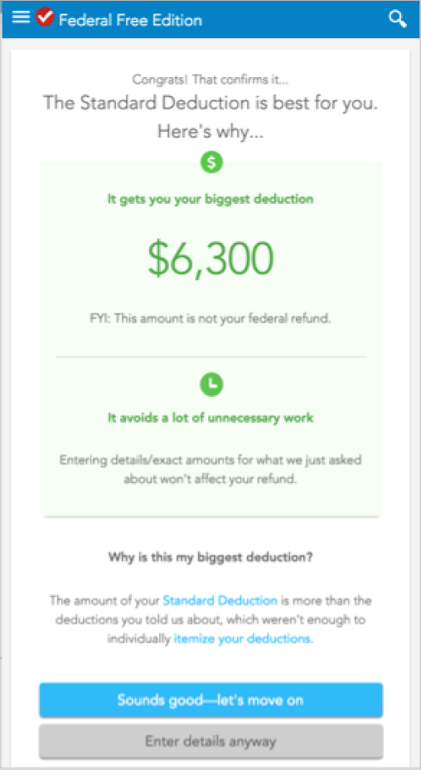
Taxpayers needed us to “show our work”
96% of customers selected the standard deduction when shown this screen.
Standard vs. itemized prediction model shortens average completion time by 1 minute.

Slide 24
Data science & design mindsets
AUC
PRECISION/RECALL
LABELS
MODELS
UNSUPERVISED
CLUSTERING
K-MEANS
HYPER-PERAMETER TUNING
3-CLICK RULE
5-SECOND TEST
60-30-10 RULE
GOLDEN RATIO
F-SHAPED PATTERN
WIREFRAME
CARD SORTING
HEATMAP
CUSTOMER SUCCESS

Slide 25

Thank you!
Q&A

